Slide 1
Predicting the Best place to open a new Indian Restaurant and Café in my City Bengaluru
Vishal Nagaraj

Slide 2
Introduction
Bengaluru is well known as Bangalore which is the capital city of the state Karnataka which belongs to the country India. Bengaluru used to call has “Garden City” now it has been changes to “Silicon city” for the IT hub and lot of start-ups.
Restaurant and cafés are the one of the major attractions for the people especially during the weekends, may be being one of the busy cities of India and people want break from kitchen at least during the weekends.
One of my friends is managing the 2 branches of the Indian restaurant and he wanted to expand his business by opening few more branches of the same restaurant along with a brand-new Café centre.
When he put up his wish, I decided to help him through suggesting the areas where business will be better for Indian restaurant and Café.

Slide 3
Data acquisition and cleaning
Data sources : Fetched the data from the Government website of India which has the details about the Zones and Area.
Through the Government website got the details about of all the Cities of Karnataka, since our focus is to fetch the information only related to Bengaluru, we deleted the details of other cities.
We were unable to fetch the Latitude and Longitude of some of the areas, since these are inducted to the Bengaluru recently.
We collected the Zone, Area, Latitude, Longitude details from many sources and filtered it as per our requirement. For us these details are enough to analyse the city.
The sample of our selection is shown below:

Slide 4
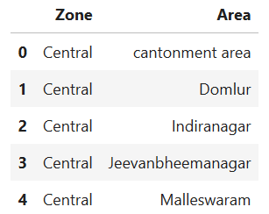
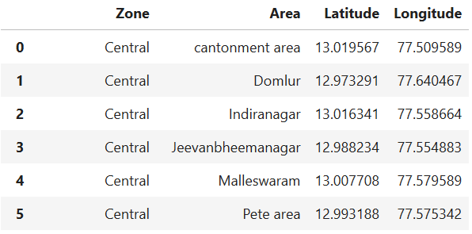
Data fetched from Government site
Data after resolving the Latitude and Longitude values

Slide 5
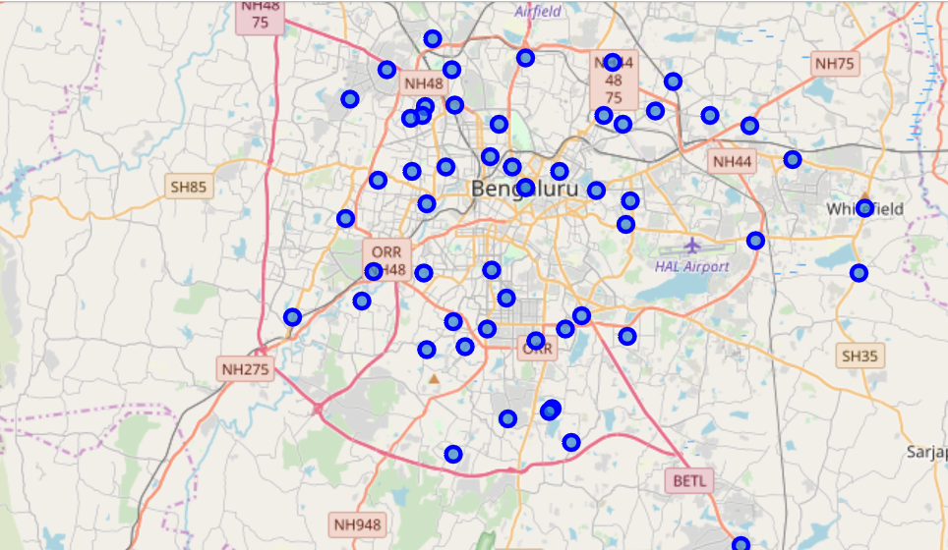
From the collected Data plot the area location on the Map

Slide 6
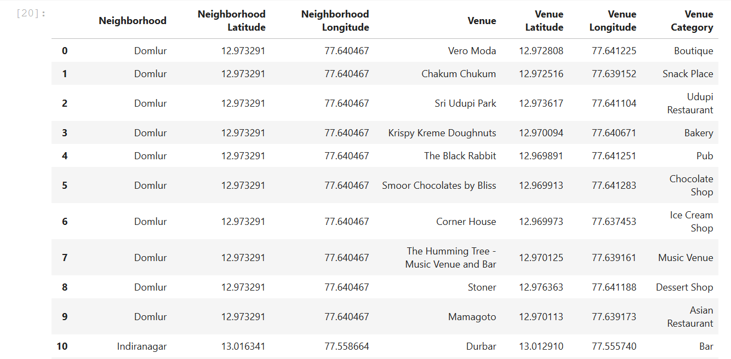
Using Data from the FourSquare fetch the top 10 Venues of each area
Feed the Latitude and the Longitude of the area to the Foursquare and fetch the data of 10 top venues of the Area

Slide 7
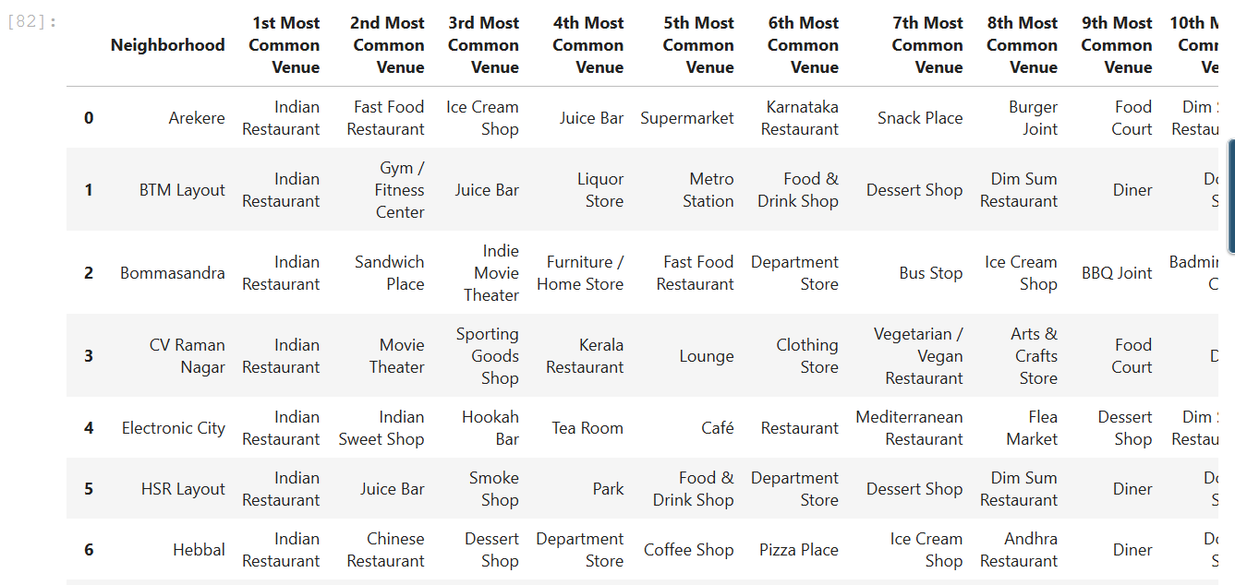
Filter off the Areas with top visitors to Indian Restaurant
After calculating the frequency of the visiting each venue, group the top 10 frequently visited venues.
Then filter the areas based on the Indian restaurant is the top most visited venues.

Slide 8
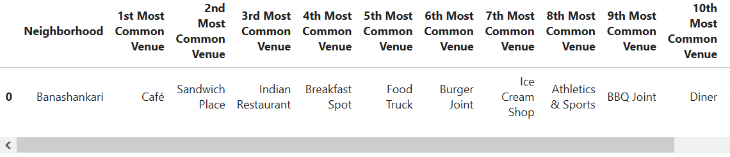
Same way find the area with frequent visitors to Café.

Slide 9
Result and conclusion.
We have the Top 20 Locality which has frequent visitors to Indian Restaurant, based on this my friend can choose the locality where to open his Next restaurant based on other criteria like near to his current restaurant, and availability of the Building/Rent of the building etc.

Slide 10
Thank you
-Vishal Nagaraj

